Slide 1


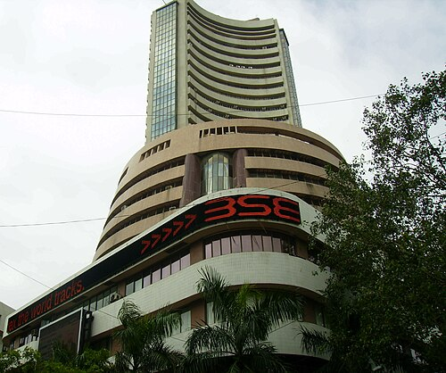
School Of Business
The Northcap University
Gurugram, India
Financial Portfolio Management
Portfolio Presentation
Strategy → Analysis → Results
Financial Portfolio Management Workshop · 5 August 2026
MBA Orientation 2026–28
Prepared Team D — Arnav Gupta • Sahil Singhal • Roshni Kumari • Hriday • Rishabh Solanki

Slide 2
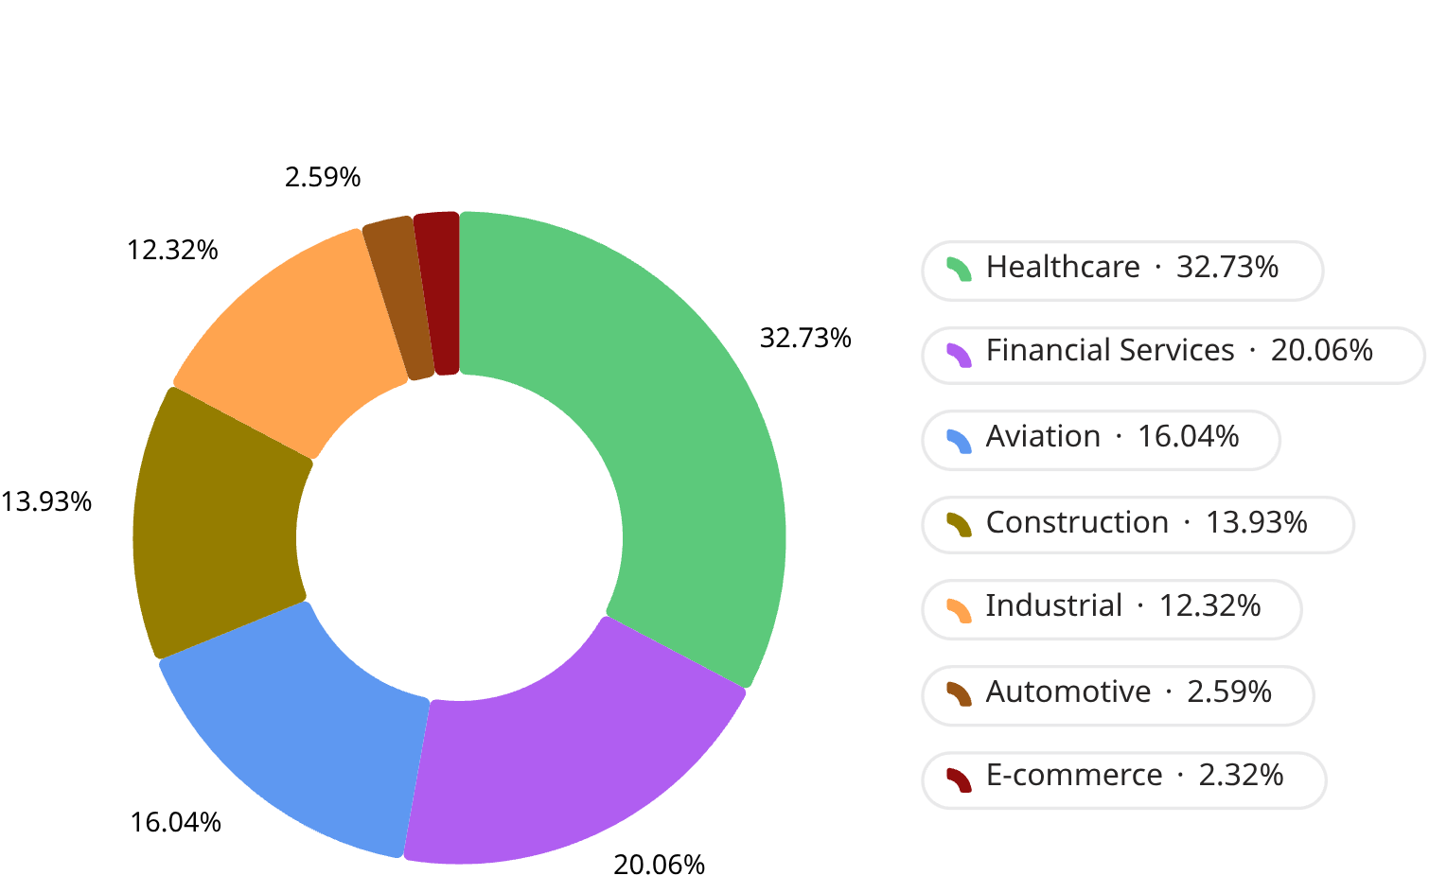
Portfolio Overview
Portfolio Snapshot & Investment Strategy
Executive Snapshot
Portfolio Allocation
Total Capital Invested
Number of Companies
₹9,99,976.72
7
Number of Sectors
Capital Utilized
7
99.99%
Evaluation Period
Investment Strategy
3 Aug 2026 → 4 Aug 2026
Diversified Growth Portfolio

Slide 3
Portfolio Allocation Strategy
Capital allocation was driven by investment conviction, expected growth potential, and prudent portfolio diversification.
Core Holdings 52.79%
Growth Holdings 42.29%
Tactical Holdings 4.91%
Foundation of the portfolio built on high-conviction investments.
Companies positioned to capitalize on long-term sectoral expansion.
Selective investments enhancing diversification and future upside.
Divi's Laboratories
Bajaj Finserv
InterGlobe Aviation
Larsen & Toubro
Siemens
Ashok Leyland
Eternal
Portfolio Objectives
Maximize portfolio returns
Maintain sector diversification
Invest in fundamentally strong companies
Balance growth and stability
Follow disciplined capital allocation

Slide 4
Core Holdings: Investment Rationale
High-conviction companies forming the foundation of our portfolio.
Divi's Laboratories
Bajaj Finserv
Healthcare
Financial Services
Investment Thesis
Investment Thesis
Leading Indian pharmaceutical company with strong global presence.
Robust fundamentals and consistent profitability.
Major exporter of Active Pharmaceutical Ingredients (APIs).
Defensive sector for long-term resilience.
Diversified financial services business.
Strong presence in lending, insurance, and wealth management.
Established brand with consistent market expansion.
Well-positioned to benefit from India's financial sector growth.
Portfolio Role
Portfolio Role
Provides portfolio stability.
Offers defensive growth.
Largest portfolio allocation (32.73%).
Enhances financial sector exposure.
Aims for long-term capital appreciation.
Second-largest portfolio allocation (20.06%).
Company Name | Quantity Purchased | Purchase Price (3rd August, ₹) | Amount Invested(₹)
Divi's Laboratories | 40 | 8182.5 | 3,27,300.00
Bajaj FinServ | 98 | 2047.4 | 2,00,645.70
Notes:
This slide provides a deep dive into the two core holdings of our portfolio: Divi's Laboratories and Bajaj Finserv. For each company, detail the sector, the specific reasons for selection, highlighting their strengths and market position, and their strategic role within the portfolio. Emphasize the high conviction behind tUse the comparison table to summarize key data points and quote to reinforce the overall significance of these holdings as the foundation of our investment strategy.

Slide 5
Growth Holdings: Investment Rationale
Companies positioned to capitalize on long-term sectoral expansion and sustainable capital appreciation.
InterGlobe Aviation Ltd
Larsen & Toubro Ltd
Siemens
Aviation
Construction & Infrastructure
Industrial
Investment Thesis
Investment Thesis
Investment Thesis
India's largest airline by market share.
Rising domestic and international air travel demand.
Efficient operations with strong cost management.
Positioned to benefit from India's expanding aviation industry.
India's leading engineering and infrastructure company.
Strong order book supported by government capital expenditure.
Diversified operations across infrastructure, defence, and technology.
Positioned for long-term infrastructure development.
Leader in industrial automation and electrification.
Benefits from manufacturing modernization.
Technology-driven business model.
Positioned for long-term industrial growth.
Strategic Role
Strategic Role
Strategic Role
Captures aviation sector growth.
Exposure to consumer mobility.
Portfolio Weight: 16.04%
Infrastructure sector exposure.
Long-term industrial growth.
Portfolio Weight: 13.93%
Industrial automation exposure.
Supports manufacturing expansion.
Portfolio Weight: 12.32%
Company Name | Quantity Purchased | Purchase Price (3rd August, ₹) | Amount Invested(₹)
Interglobe Aviation Ltd | 30 | 5,346.00 | 1,60,380.00
Larsen & Toubro Ltd | 35 | 3,980.00 | 1,39,300.00
Siemens | 33 | 3,734.60 | 1,23,241.80
Notes:
This slide details the strategic growth holdings that capture long-term sectoral expansion. For each company (InterGlobe Aviation, Larsen & Toubro, and Siemens), highlight their sector, the key investment thesis supporting their selection, and their strategic role within the portfolio. Emphasize how these holdings align with India's long-term growth trends in aviation, infrastructure, and industrial automation. The table provides specific transaction details for transparency, and the concluding quote summarizes their collective impact and contribution to portfolio diversification.

Slide 6
Tactical Holdings: Investment Rationale
Selective investments chosen to enhance portfolio diversification while capturing niche growth opportunities.
Ashok Leyland
Eternal
AUTOMOTIVE
E-COMMERCE
Investment Thesis
Investment Thesis
One of India's leading commercial vehicle manufacturers.
Well-positioned to benefit from infrastructure and logistics expansion.
Strong presence in the commercial vehicle segment.
Attractive long-term cyclical growth potential.
Represents India's rapidly expanding digital economy.
Exposure to long-term growth in online commerce.
Technology-driven business with scalable operations.
Complements traditional sectors within the portfolio.
Strategic Role
Strategic Role
Provides automotive sector exposure.
Strengthens portfolio diversification.
Portfolio Weight: 2.59%
Adds exposure to digital consumer businesses.
Supports long-term portfolio diversification.
Portfolio Weight: 2.32%
Company Name | Quantity Purchased | Purchase Price (3rd August, ₹) | Amount Invested(₹)
Ashok Leyland | 151 | 171.72 | 25929.72
Eternal | 76 | 305.00 | 23,180.00
Notes:
This slide outlines our tactical holdings, Ashok Leyland and Eternal, which are strategically chosen to enhance portfolio diversification and capitalize on specific niche growth opportunities. For each company, I will detail their respective sectors, the key investment thesis that supports their inclusion, and their strategic role in complementing our overall portfolio structure. I will emphasize how these smaller allocations contribute to portfolio balance by introducing exposure to the automotive and burgeoning digital commerce sectors, reflecting our adaptability to market trends. The accompanying table provides transparent details on the quantities purchased and the exact investment amounts for each tactical holding. The concluding quote summarizes their collective impact on diversification and growth within the portfolio.

Slide 7
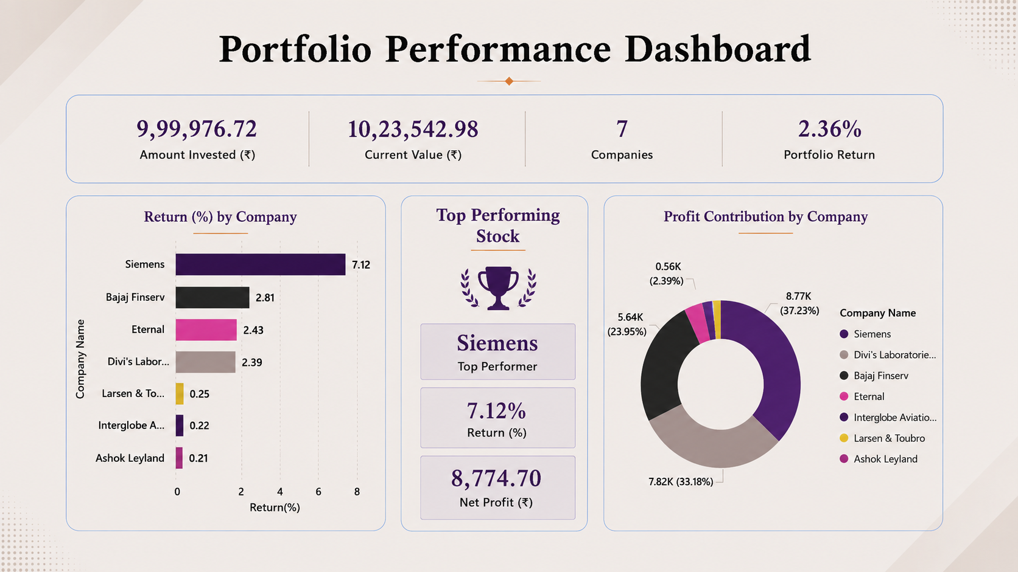

Slide 8
Portfolio Performance Analysis
An evaluation of portfolio performance based on individual stock returns and overall investment outcomes.
Company | Return (%) | Net Profit (₹) | Performance
🥇 Siemens | 7.12% | 8,774.70 | ⭐ Best Performer
Bajaj FinServ | 2.81% | 5,644.80 | Strong
Eternal | 2.43% | 562.40 | Good
Divi's Laboratories | 2.39% | 7,820.00 | Strong
Larsen & Toubro | 0.25% | 350.00 | Stable
InterGlobe Aviation | 0.22% | 360.00 | Stable
Ashok Leyland | 0.21% | 54.36 | Stable
Overall Portfolio Return
Total Net Profit
2.36%
₹23,566.26
Notes:
This slide provides a detailed analysis of the portfolio's performance, breaking down returns by individual stock and highlighting overall results. On the left, I've presented a table summarizing each company's return, net profit, and a brief performance descriptor. I've highlighted Siemens as the best performer, as requested. Below the table, two KPI boxes clearly display the overall portfolio return and total net profit. The right section, "Key Observations," uses small icons to present five key takeaways from the performance data, offering qualitative insights alongside the quantitative figures. I will discuss how the diversified strategy led to a profitable outcome across all holdings and emphasize the strong performance of Siemens, Divi's Laboratories, and Bajaj Finserv.

Slide 9
Hindsight Analysis: What We'd Do Differently
Reflecting on our investment decisions after evaluating the portfolio's actual performance.
What Worked Well
What We'd Do Differently
Diversified Portfolio: Investments across 7 holdings reduced risk and improved balance.
100% Positive Returns: Every selected stock generated a positive return.
Top Performer: Siemens delivered the highest return (7.12%) and profit contribution.
Strong Performer: Divi's Laboratories produced consistent returns and strong profitability.
Increase Siemens Allocation: Allocate more capital to Siemens due to its superior performance.
Boost Divi's Investment: Increase exposure to Divi's Laboratories based on its strong returns.
Reduce Ashok Leyland: Lower allocation to improve overall portfolio returns.
Reallocate Capital: Shift funds from lower-return to high-conviction stocks.
Optimize Portfolio Weights: Adjust allocations based on conviction while maintaining diversification.

Slide 10
Conclusion
Summary of portfolio performance and key investment learnings.
Portfolio Outcomes
Key Learnings
Successfully invested within the ₹10 lakh limit.
Achieved an overall portfolio return of 2.36%.
Generated a total profit of ₹23,566.26.
All 7 holdings delivered positive returns.
Diversification helped balance portfolio risk.
Strong stock selection supported positive returns.
Capital allocation plays a crucial role in portfolio performance.
Continuous portfolio monitoring improves investment decisions.

Slide 11
We appreciate your time and effort
THANK YOU!

